Slide 1
SUS COPTIC Diocese Weekly Newsletter
newsletter@suscopts.org
FL Hymns Camp
Boys: Jun 3-6, 2018
Girls: Jun 11-14, 2018
http://flhymnscamp.eventzilla.net
BOLD Evangelism Conference
Jul 13-15, 2018
more info coming soon

Slide 2
Learn How To Build
A Coherent Team
Recognize The 5 Dysfunctions That Destroy An Organization
Learn And Develop Personal Leadership
And Communication
LEAD Beyond Conference June 8-10, 2018
Registration Deadline April 30, 2018
https://www.theleadprogram.org/lead-beyond

Slide 3
Family Ministry Program
FMP Counseling Education
To Train Lay Christian Helpers
http://fmp.suscopts.org/
Summer Registration ~ May 1, 2018

Slide 4
5th Annual Extreme Family Makeover Convention!
The most rewarding home improvement project we'll ever undertake is renovating the spirituality of our families!
May 4 – 6, 2018
Speakers
HE Metropolitan Antonius
HG Bishop Youssef
https://copticefm.suscopts.org/

Slide 5
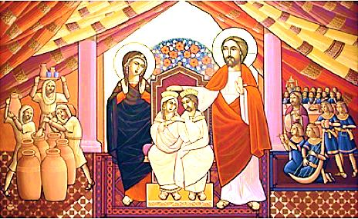
2018-2019 PRE-MARITAL RETREATS
Georgia: May 18-20, 2018
Register by May 4, 2018
Texas: November 9-11, 2018
Florida: January 11-13, 2019
Tennessee: 2019 TBD [Arabic]
for all couples intending to marry within the year
https://www.suscopts.org/programs/pre-marital/

Slide 6
OCCM
Youth Mission Trip
EGYPT
July 9 – 25, 2018
$2400 Includes Accommodations & Group Airfare from MCO
18 Spots Only: Register & Submit Deposit by May 1, 2018
http://susoccm.wixsite.com/egyptmission

